Slide 1
How CMEs Expand in the Heliosphere
By Aaron Williams
Mentor: Teresa Nieves-Chinchilla

Slide 2
Motivation
How does the CME evolve in the Interplanetary medium?
Radial propagation
Self-similar expansion
Introduction
This part of a project ….. NSF ST (Solar-Terrestrial):
“Collaborative Research: Reconciliation between in-situ and remote.”
What is a CME? - Remote sensing observations analyses

Slide 3
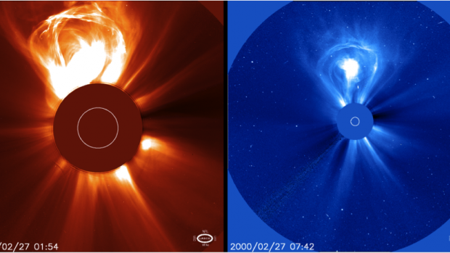
What are CMEs
A Coronal Mass Ejection(CME) happens when giant clouds of plasma are ejected from the Sun.
CMEs have been observed for years but they are still not fully understood. Scientists know that the Sun’s magnetic field is a factor in there creation.

Slide 4
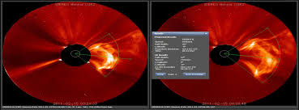
Methodology
Based on Inner Heliospheric Evolution of a ‘stealth’ CME derived from multi-view imaging and multipoint in-situ observations, by Nieves-Ch. et al. 2012.
Using STEREOCat Tool – STEREOCat is a tool that takes CME pictures taken by spacecrafts like SOHO and determines there speed and angular width .

Slide 5
What We Expected
radial propagation of the CMEs would be constant
Self-similar expansion

Slide 6
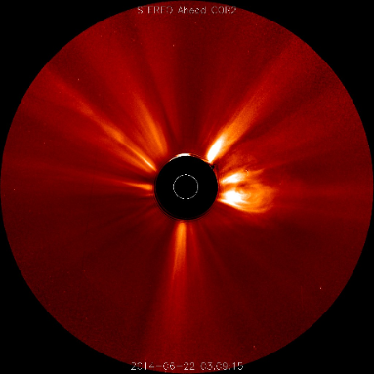
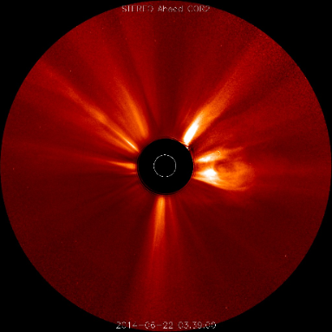
CASE - non constant angular width CME 2014-06-22 173

Slide 7
CASE - constant angular width CME 2013-03-17 076
Notes:
-

Slide 8
Results
CME | # of Point | Difference (deg) | Constant (Y/N)
2014-06-29 180 STA CORO 2 | STA CORO 2 = 9 SOHO C3 = 8 | 7 2 | N Y
2013-01-06 016 SOHO C2 | STA CORO 2 = 8 SOHO C3 = 5 SOHO C2 = 5 | 7 3 6 | N Y N
2013-03-17 076 STA CORO 2 | STA CORO 2 = 8 STB CORO 2 = 8 3D = 8 | 2 0 0 | Y Y Y
2013-04-14 134 STB CORO 2 | STB CORO 2 = 5 | 6 | N
2013-07-04 186 STB CORO 2 | STA CORO 2 = 5 STB CORO 2 = 5 3D = 5 SOHO C3 = 5 | 0 0 0 2 | Y Y Y Y
2013-07-18 199 SOHO C2 | STA CORO 2 = 6 STB CORO 2 = 6 3D = 6 SOHO C2 = 3 | 2 2 4 2 | Y Y Y Y
2013-08-31 243 SOHO C2 | STA CORO 2= 13 SOHO C3 = 4 SOHO C2 = 3 | 2 14 3 | Y N Y
2013-10-02 275 STA CORO 2 | STA CORO 2= 10 STB CORO 2= 10 SOHO C3= 6 | 1 8 0 | Y N Y

Slide 9
2013-10-08 282 SOHO C2 | STA CORO 2 = 4 STB CORO 2 = 4 3D = 4 SOHO C3 = 8 | 0 0 0 2 | Y Y Y Y
2014-04-20 111 SOHO C2 | STA CORO 2 = 6 STB CORO 2 = 6 SOHO C3 = 6 SOHO C2 = 3 | 0 0 0 0 | Y Y Y Y
2014-06-22 173 STA CORO 2 | STA CORO 2 = 5 | 3 | Y
2012-01-21 021 STA CORO 2 | STA CORO 2 = 5 | 0 | Y
2012-01-22 022 STA CORO 2 | STA CORO 2 = 3 STB CORO 2 = 3 | 0 0 | Y Y
2013-03-12 072 STB CORO 2 | STB CORO 2 = 8 SOHO C3 = 7 | 2 0 | Y Y
2014-06-22 173 STA CORO 2 | STA CORO 2 = 5 STB CORO 2 = 5 3D = 5 | 5 6 5 | N N N
TOTAL | 238 |  | Yes = 32
 |  |  | No = 9

Slide 10
Conclusion
Non-constant radial propagation and self-similar expansion in some CME events
Something is causing the CMEs to expand at a non-constant rate
This is important to space weather forecasters

